Slide 2
LOGIC GATES
AND
TRUTH TABLE.
CIT,2- Year ELT-II

Slide 3
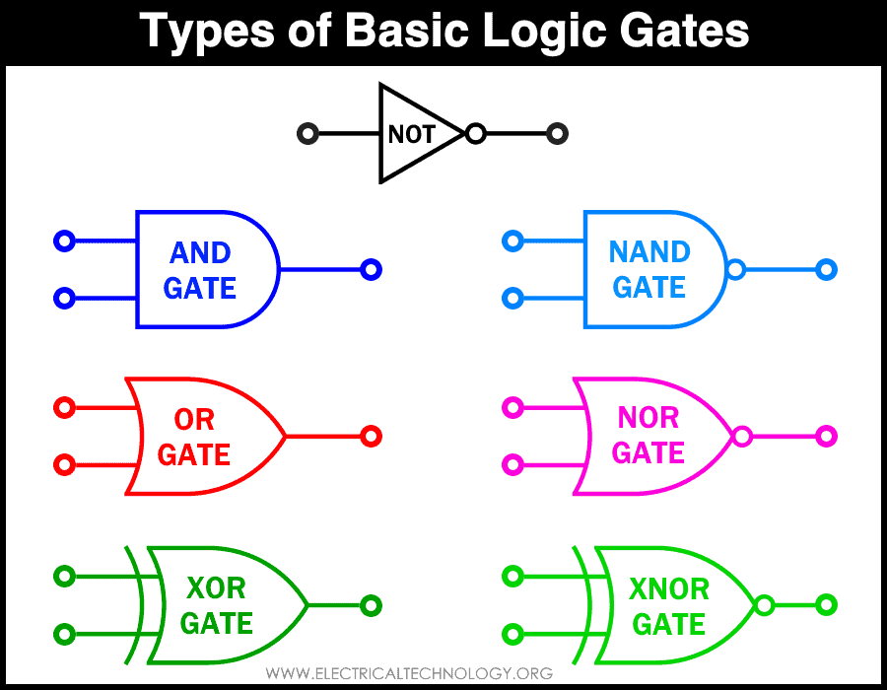
CIT,2- Year ELT-II

Slide 4
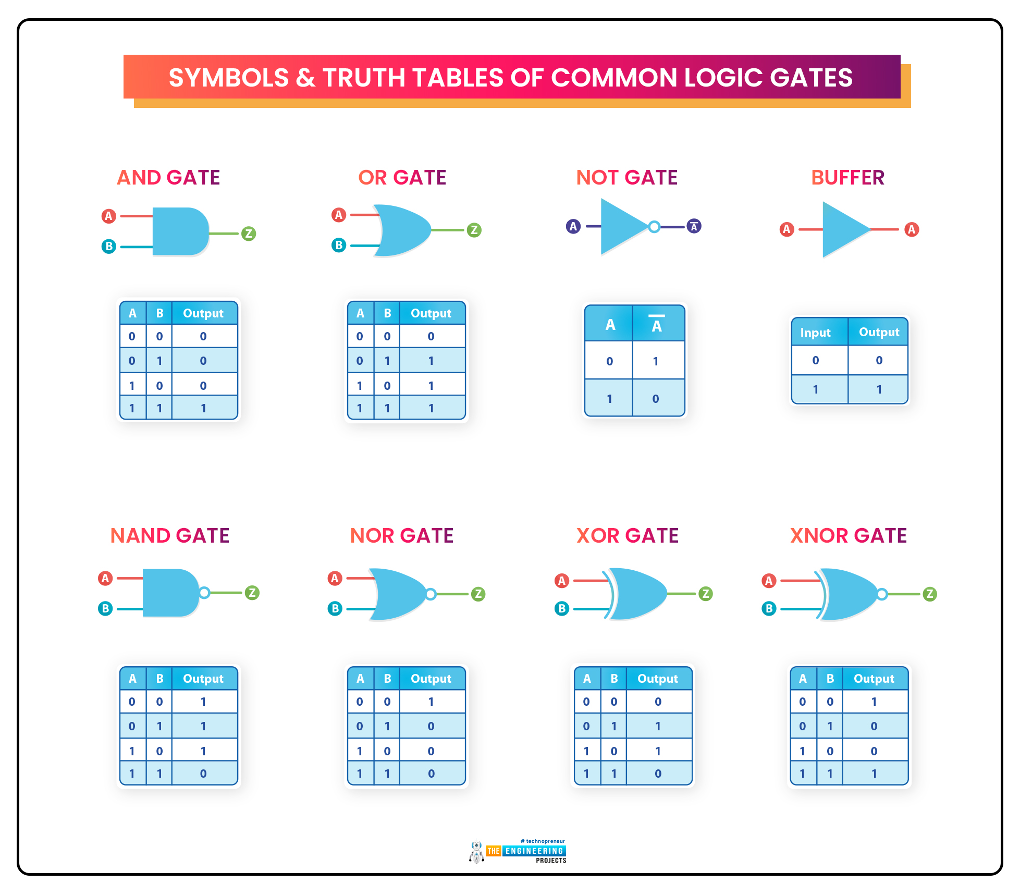
CIT,2- Year ELT-II

Slide 5
CIT,2- Year ELT-II

Slide 6
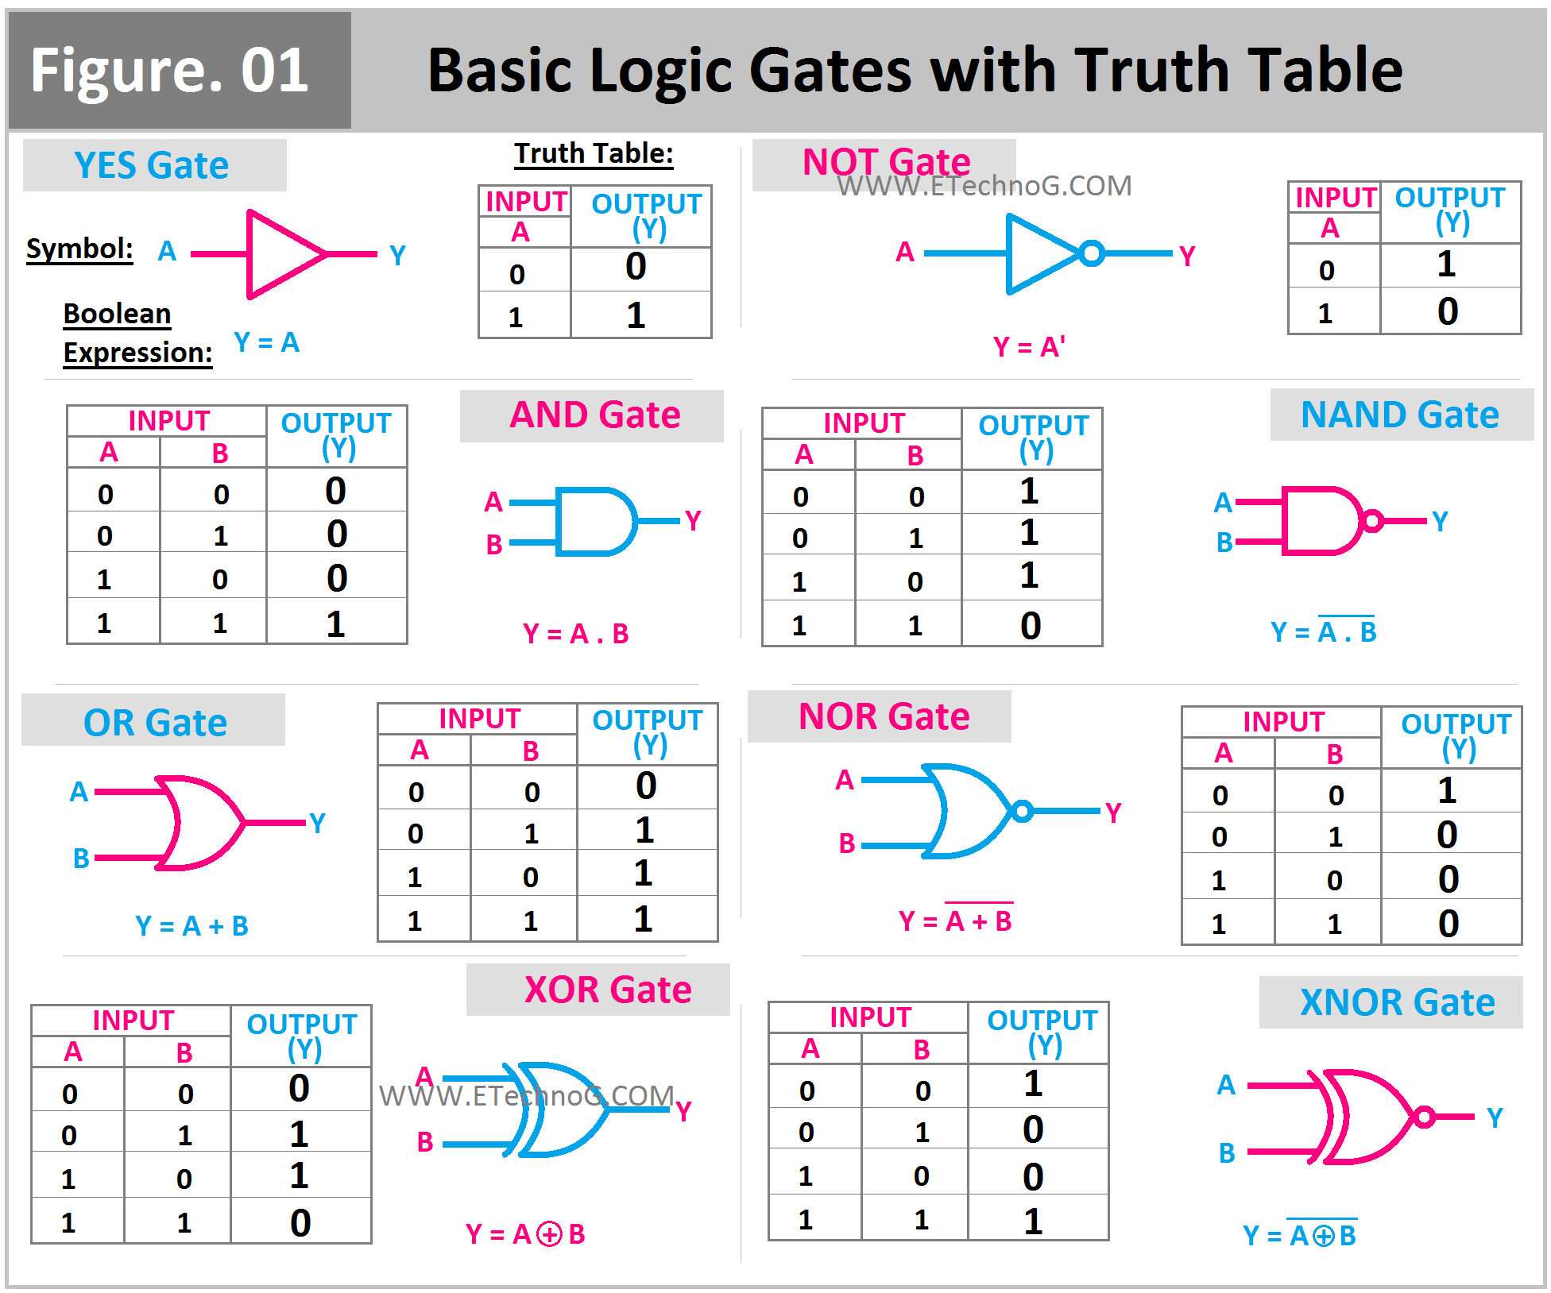
CIT,2- Year ELT-II

Slide 7
Logic gates
AND: The output is 1 (True) only if all inputs are 1.
OR: The output is 1 (True) if at least one of the inputs is 1.
NOT: The output is the logical opposite of the single input. If the input is 1, the output is 0. If the input is 0, the output is 1.
NAND: The output is 0 only if all inputs are 1. It is the inverse of the AND gate.
NOR: The output is 1 only if all inputs are 0. It is the inverse of the OR gate.
XOR (Exclusive OR): The output is 1 if the inputs are different, and 0 if they are the same.
XNOR (Exclusive NOR): The output is 1 if the inputs are the same, and 0 if they are different.
CIT,2- Year ELT-II

Slide 8
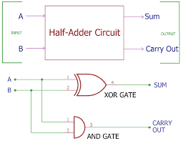
Half Adder
half adder is a digital logic circuit that adds two single-bit binary numbers, producing a "Sum" bit and a "Carry" bit. It consists of an XOR gate for the sum and an AND gate for the carry. This circuit is limited to adding only two bits and cannot handle a carry input from a previous stage.
CIT,2- Year ELT-II

Slide 9
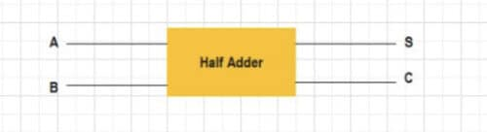
A | B | Sum (S) | Carry (C)
0 | 0 | 0 | 0
0 | 1 | 1 | 0
1 | 0 | 1 | 0
1 | 1 | 0
CIT,2- Year ELT-II

